Slide 1






CALIFORNIA ELEMENTARY HIKING DAY
Trip Date:
Saturday, May 16, 2026

Slide 2
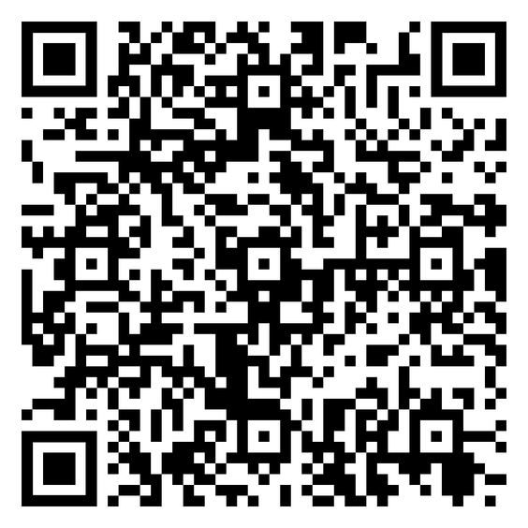
ATTENDANCE
Thttps://docs.google.com/forms/d/e/1FAIpQLScDiW_19e2txx2vKHc9jAON0jTZBp7zQKT-HQP4KjgyK988RA/viewform?usp=publish-editor

Slide 3



Meeting Agenda
  Important Dates and Information
  Itinerary
  List of what to bring (Packing List)
  Hiking Rules
  FVF Policies
  Contact Information

Slide 4




Important Dates and Information
Turn permission slips to FVF office (L-1) or you may take a picture, scan, or upload your PS via email @ fvfofficers@gmail.com Any issues contact Yuridia Duran
(626) 388-6123. All enrollment forms must be completed for junior venturer to attend.
Group chat: All attendees will be placed in a text group chat 1-2 days prior to the event/outing.
Permission slips are Due by Friday, May 8, 2026
ONE adult is required to attend with each Junior venturer.

Slide 5


Itinerary
Saturday May 16, 2026:
8:30am-9:00am Load Up/ Count off. Attendees need to have breakfast before coming. Use
restrooms, fill water bottles (if needed) assign cars, count off.
9:00am-10:30am Drive to Switzer Falls Trailhead on Hwy 2. Ranger Station (760) 316-7828.
701 Angeles Crest Hwy, Tujunga, CA 91042.
10:30am-12:00pm Count off, make groups, assign lead and tail for each group, review hiking rules,
confirm everyone has a full water bottle. Use Restrooms. Lunches can stay in the car,
they do not need to be carried during the hike. Snacks are optional. Turnaround time
45min. Hike about 1-2 miles.
12:00pm- 12:45pm Count off, lunch time. Clean-up.
1:00pm - 2:00pm Set up games, play games, handout prizes to winners.
2:00pm- 3:30pm Drive back to California Elementary
1111 N California Ave, La Puente, CA 91744
3:30pm Arrive at the California Elementary, check for trash and any items left behind.

Slide 6




Packing List.
Ten Essentials: DAY PACK (will contain all of the following items)
Water Bottle (Dishwasher Safe, 32 oz - 36 oz)
Travel size First Aid Kit FVF $3.00
Wrist Watch (cell phone OK)
Clothing:
Sweater or Windbreaker (morning)
Shoes with good grip for hiking
Optional: Extra shoes/sandals for wet shoes during the trail. We will have stream crossings

Slide 7
Packing List.
Things to bring for the hike:
1 Sack Lunch
Sandals/Slippers (to leave in the car incase your shoes get wet)
Comfortable pants and shirt (avoid cotton material)
Toiletries (baby wipes or hand sanitizer, toilet paper (put in a ziploc bag)
Plastic Grocery Bags (2+). Bag for trash and wet shoes
Medication: If needed
Optional:
Camera / Sunblock / Sun Hat / Sun Glasses / Chapstick

Slide 8




Hiking Rules
HEAD AND TAIL: When hiking, always assign a HEAD and TAIL. The TAIL should be the FASTEST hiker while the HEAD should be the SLOWEST hiker. No one passes the HEAD and no one fails behind the TAIL. This makes sure that everyone is together and no one gets left behind.
HEAD: As the HEAD you are the leader of the hike and must always stop at…
Fork in the Road
Stream Crossings
Assigned Time
TAIL: As the TAIL you are the one responsible to make sure everyone else is keeping up. You will be the one to alert everyone if someone is injured and take care of them.
ASSIGNED TIMES: Keep assigned times to 20 min to 30 min intervals and remember to drink water at every step. Stay on the trail. Do not cut the trail.

Slide 9

FVF Policies Review
LOST AND FOUND POLICY: Anything left behind on trips will go to the Felix Ventures Foundation Lost and Found. You have 7 days to claim your things before it is donated to the Salvation Army
ELECTRONICS POLICY: No use of Phones, iPods, or Gaming Devices allowed DURING any FVF activities. Phone Use will ONLY be allowed in case of emergency. (you got lost in the bike trail)
PERMISSION SLIP: First come first serve basis! Must have all your paperwork turned in!

Slide 10
Contact:
Yuridia Duran
Managing Director
THANK YOU
FOR ATTENDING
QUESTIONS?
(626) 388-6123
Jamie Moreland
Program Director
(818) 731-3842

Slide 11
ATTENDANCE
Thttps://docs.google.com/forms/d/e/1FAIpQLScDiW_19e2txx2vKHc9jAON0jTZBp7zQKT-HQP4KjgyK988RA/viewform?usp=publish-editor

Slide 12
Felix Ventures Website
Felixventures.org

